Slide 1

Derivative Problem Examples Part 1
RCET 0264 Introductory Calculus
Tim Leishman

Slide 2

Derivative Problem Examples Part 1
To take the derivative of any function we can follow the following steps:
If $y=ax^{n}$ ,then $\frac{dy}{dx}=anx^{n−1}$
$y$ is $y$ and $x$ is $x$
$a$ is the number in front of $x$
$n$ is the exponent of $x$

Slide 3
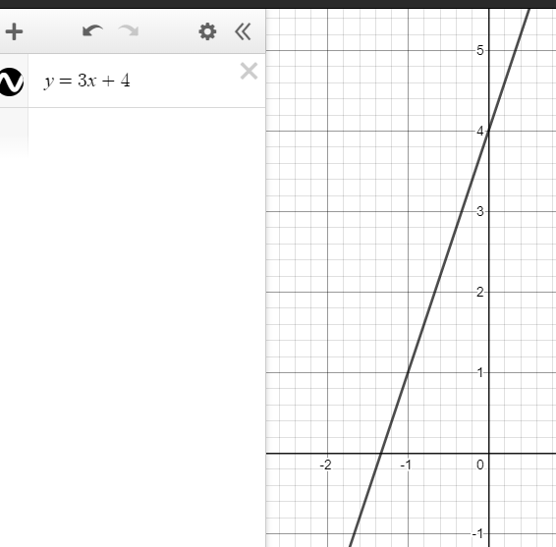

Derivative Problem Examples Part 1
If $y=ax^{n}$ ,then $\frac{dy}{dx}=anx^{n−1}$
Q$uestion 1.$
$$y=3x+4$$
$$y=3x^{1}+4x^{0}$$
Derivative:
$$\frac{dy}{dx}=3\left(1\right)\left(x^{\left(1−1\right)}\right)+4\left(0\right)\left(NA\right)$$
$$\frac{dy}{dx}=3\left(x^{\left(0\right)}\right)+0$$
$$\frac{dy}{dx}=3\left(1\right)+0$$
$$\frac{dy}{dx}=3$$

Slide 4
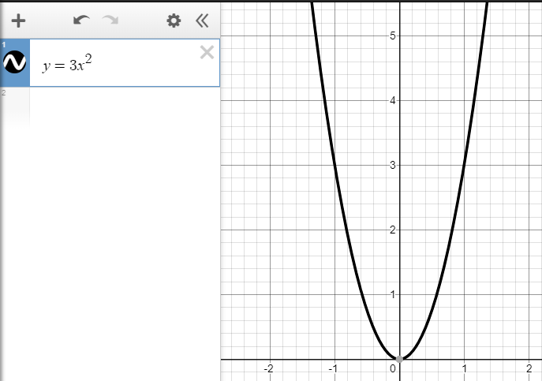

Derivative Problem Examples Part 1
If $y=ax^{n}$ ,then $\frac{dy}{dx}=anx^{n−1}$
Q$uestion 2.$
$$y=3x^{2}$$
Derivative:
$$\frac{dy}{dx}=3\left(2\right)\left(x^{\left(2−1\right)}\right)$$
$$\frac{dy}{dx}=6\left(x^{\left(1\right)}\right)$$
$$\frac{dy}{dx}=6x$$

Slide 5
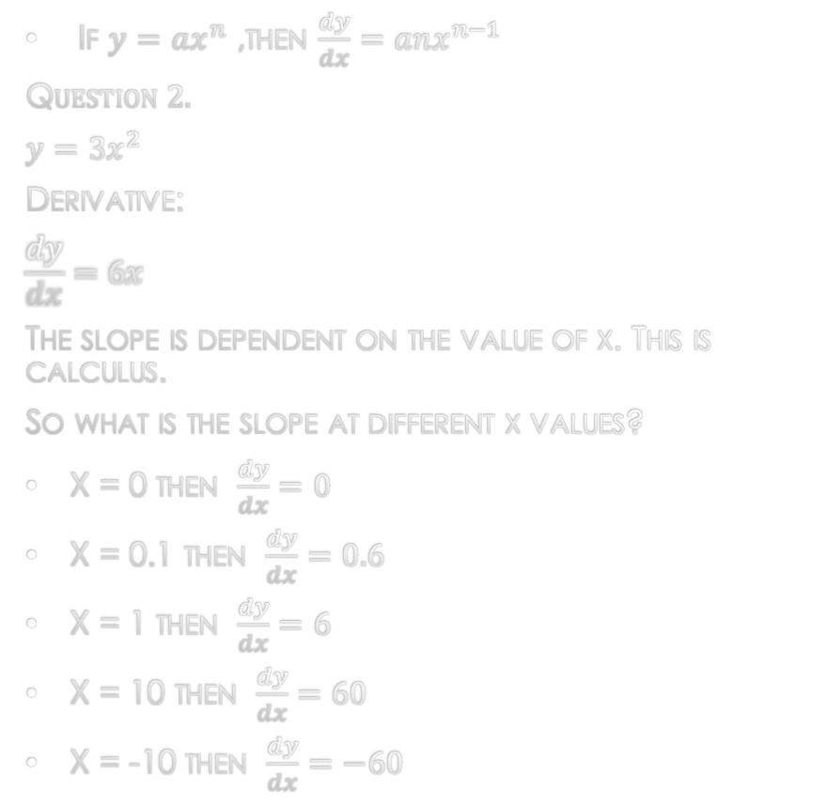
Derivative Problem Examples Part 1
If $y=ax^{n}$ ,then $\frac{dy}{dx}=anx^{n−1}$
Q$uestion 2.$
$$y=3x^{2}$$
Derivative:
$$\frac{dy}{dx}=6x$$
The slope is dependent on the value of x. This is calculus.
So what is the slope at different x values?
X = 0 then $\frac{dy}{dx}=0$
X = 0.1 then $\frac{dy}{dx}=0.6$
X = 1 then $\frac{dy}{dx}=6$
X = 10 then $\frac{dy}{dx}=60$
X = -10 then $\frac{dy}{dx}=−60$

Slide 6
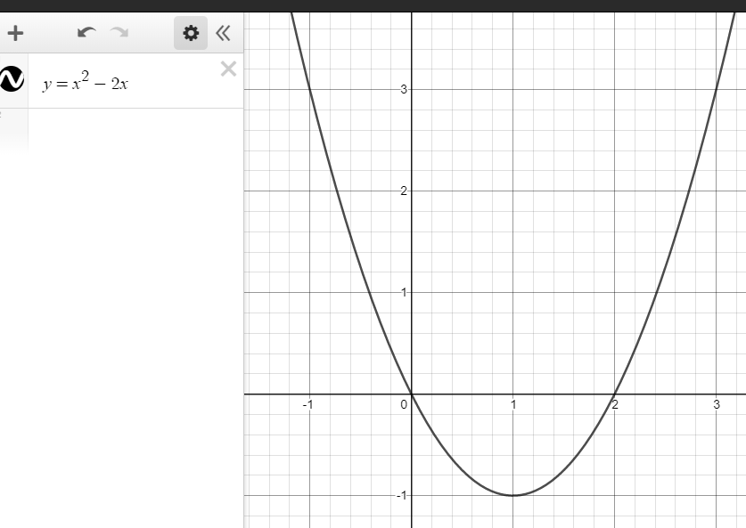
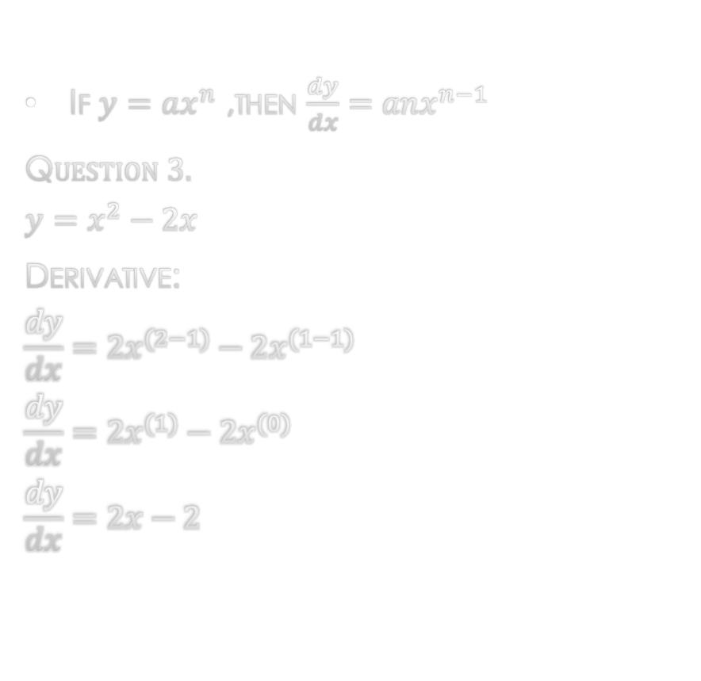
Derivative Problem Examples Part 1
If $y=ax^{n}$ ,then $\frac{dy}{dx}=anx^{n−1}$
Q$uestion 3.$
$$y=x^{2}−2x$$
Derivative:
$$\frac{dy}{dx}=2x^{(2−1)}−2x^{(1−1)}$$
$$\frac{dy}{dx}=2x^{(1)}−2x^{(0)}$$
$$\frac{dy}{dx}=2x−2$$

Slide 7
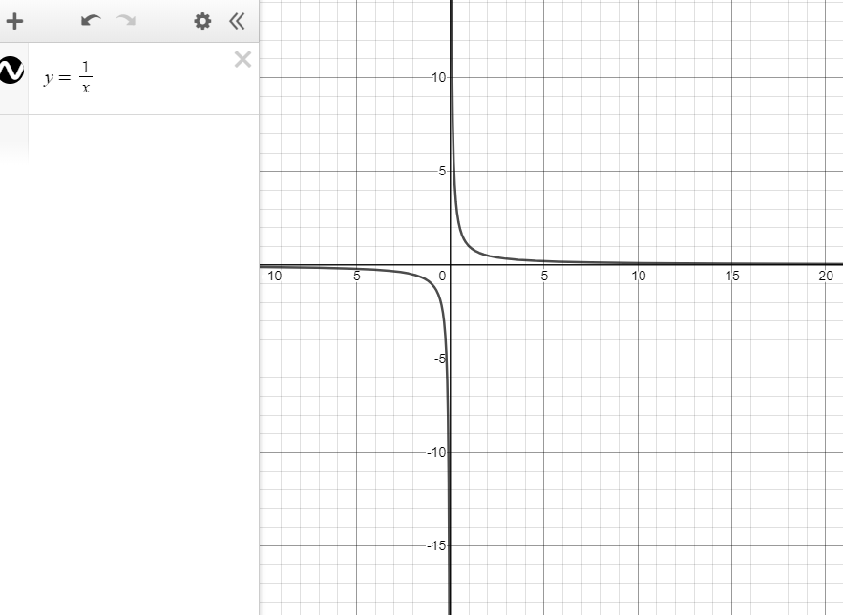
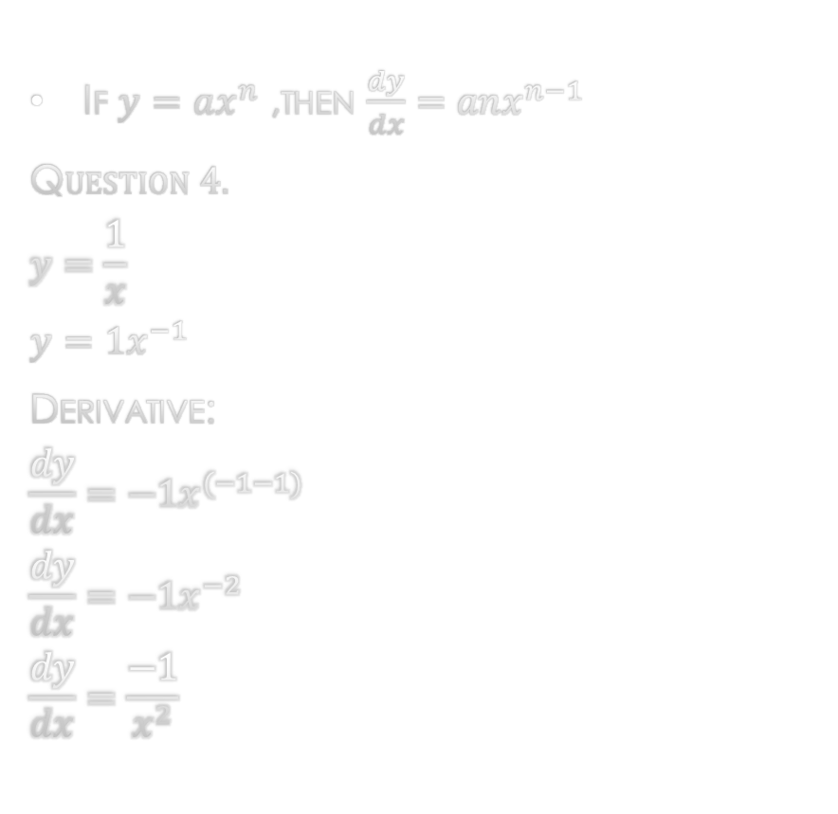
Derivative Problem Examples Part 1
If $y=ax^{n}$ ,then $\frac{dy}{dx}=anx^{n−1}$
Q$uestion 4.$
$$y=\frac{1}{x}$$
$$y={1x}^{−1}$$
Derivative:
$$\frac{dy}{dx}=−1x^{(−1−1)}$$
$$\frac{dy}{dx}=−1x^{−2}$$
$$\frac{dy}{dx}=\frac{−1}{x^{2}}$$

Slide 8
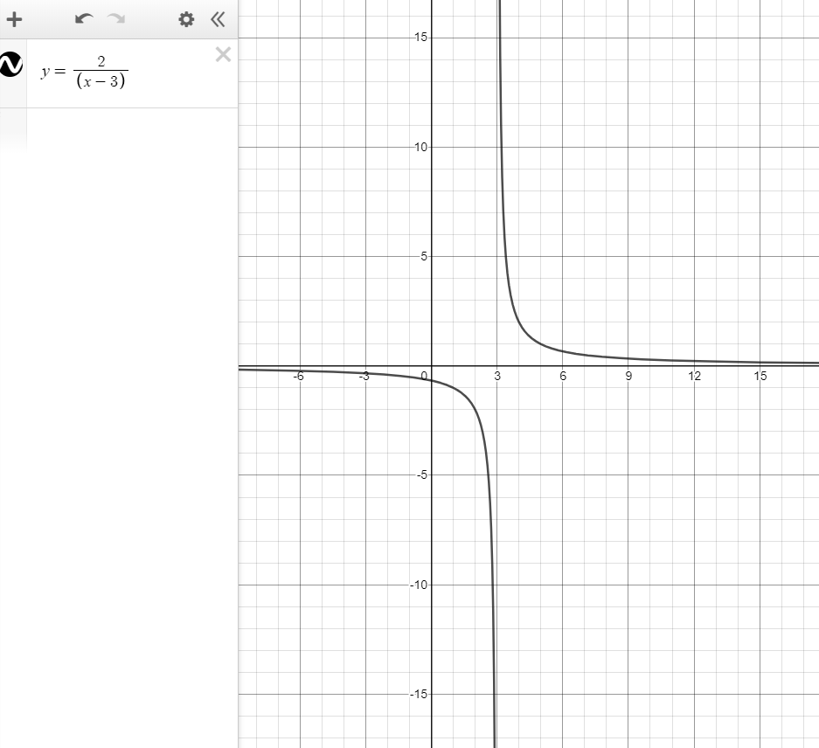
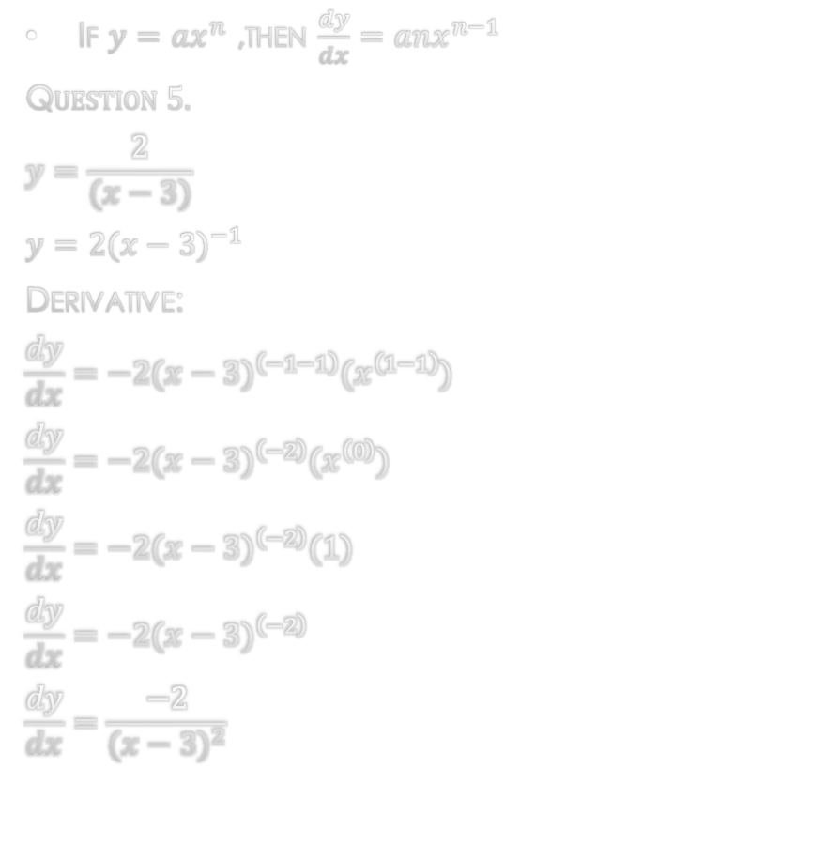
Derivative Problem Examples Part 1
If $y=ax^{n}$ ,then $\frac{dy}{dx}=anx^{n−1}$
Q$uestion 5.$
$$y=\frac{2}{(x−3)}$$
$$y=2{(x−3)}^{−1}$$
Derivative:
$$\frac{dy}{dx}=−2({x−3)}^{\left(−1−1\right)}(x^{\left(1−1\right)})$$
$$\frac{dy}{dx}=−2({x−3)}^{\left(−2\right)}(x^{\left(0\right)})$$
$$\frac{dy}{dx}=−2({x−3)}^{\left(−2\right)}(1)$$
$$\frac{dy}{dx}=−2({x−3)}^{\left(−2\right)}$$
$$\frac{dy}{dx}=\frac{−2}{{(x−3)}^{2}}$$

Slide 9
References:
Ewen, D., Gary, J. S., & Trefzger, J. E. (2005). Technical calculus. Upper Saddle River, NJ: Pearson/Prentice Hall.
Richmond, A. E., & Hecht, G. W. (1995). Calculus for electronics. New York: Glence.
https://www.desmos.com

